Slide 1
Speech Emotion Recognisation
Team_4019
Parul Institute of Engineering and Technology
J. Chanakya
P. Lokesh
B. Venkata Siva Rama Krishna
K. Taraka Satya Bala Ujwal
K. Guru Vishnu

Slide 2
AGENDA
Finding the emotion of the speaker?
Using the datasets for recognising the emotions.

Slide 3
PROBLEM STATEMENT
The goal of this project is to develop an accurate and efficient system for automatically detecting and classifying human emotions from speech signals.
Emotions are an essential part of human communication and can convey important information about a speaker's mental state, intention, and attitude.
The primary objective of this project is to design a machine learning or deep learning-based model that can classify emotions accurately, such as anger, happiness, sadness, fear, and neutral, from speech signals.

Slide 4
PROJECT OVERVIEW
The goal of a SER system is to accurately classify an audio sample into one or more emotional categories, such as happy, sad, angry, or neutral.
SER is an important area of research because it has many practical applications, such as improving human-computer interaction, developing personalized healthcare applications, and enhancing speech-based emotion analysis in fields such as psychology, sociology, and linguistics.
A typical SER project involves collecting and preprocessing audio data, extracting relevant features from the audio signal, and training a machine learning model to classify emotions based on these features.
Some of the commonly used audio features for SER include Mel-frequency cepstral coefficients (MFCCs), pitch, energy, and spectral centroid.
To train a machine learning model, researchers use a labeled dataset containing audio samples and their corresponding emotional labels.
The dataset is divided into training, validation, and testing sets, and the model is trained on the training set, validated on the validation set, and evaluated on the testing set.

Slide 5
WHO ARE THE END USERS?
The end users of a speech emotion recognition project can vary depending on the specific application and context in which it is used. Here are a few examples of potential end users:
Researchers
Speech therapists
Call center representatives
Law enforcement agencies
Entertainment industry

Slide 6
THE WOW FACTOR IN OUR SOLUTION
Accuracy: The ability of the speech recognition system to accurately recognize emotions in speech is a key measure of its effectiveness. If the project is able to achieve a high degree of accuracy in recognizing emotions in speech using TESS, that could be considered a "wow factor."
Speed: Another possible "wow factor" could be the speed with which the speech recognition system is able to recognize emotions in speech. If the system can recognize emotions in real time, for example, that could be a significant achievement.
Novelty: The use of TESS to train a speech recognition system to recognize emotions in speech is itself a relatively novel approach, and could be considered a "wow factor" if the project is able to achieve good results using this method.
Applications: Finally, the "wow factor" of a speech recognition system project using TESS could also depend on the potential applications of the technology. For example, if the system is able to recognize emotions in speech in a way that could be used to improve mental health treatment, customer service, or other areas, that could be a significant achievement with broad implications.

Slide 7
MODELLING
Data Collection
Feature
Extraction
Feature
Normalization
Model
Selection
Deployment
Model
Optimization
Model
Evaluation
Training the model

Slide 8
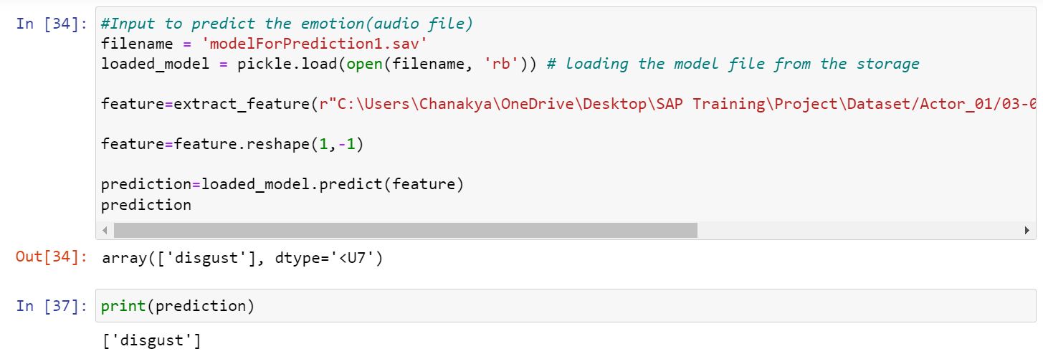
RESULTS
If we give input(audio file) it will predict the emotion.
Demo/Github Link :https://github.com/Chanakya05/Code_Unnati/tree/main

Slide 9
CONCLUSION
Speech Emotion Recognition (SER) is a rapidly growing field of research and development, which focuses on identifying and analyzing human emotions from speech signals.
With the increasing use of voice-activated personal assistants, virtual agents, and other speech-based applications, the demand for SER technology is growing rapidly.
Recent advancements in machine learning and deep learning techniques have enabled the development of accurate and robust SER models.
Overall, Speech Emotion Recognition has immense potential in a wide range of applications, including healthcare, customer service, and human-robot interaction.
As the technology continues to evolve, we can expect to see more sophisticated and accurate SER models in the future.

Slide 10





MEET OUR TEAM
J. Chanakya
P. Lokesh
B. V. S. Rama Krishna
K. T. S. B. Ujwal
K. Guru Vishnu

Slide 11
References
The Source code is available at the github link: Github Link :
https://github.com/Chanakya05/Code_Unnati/tree/main
The dataset we used is speech_emotion_Recognisation is RAVDESS dataset.
Dataset Link: https://www.kaggle.com/datasets/uwrfkaggler/ravdess-emotional-speech-audio

